Slide 1

a snapshot OF csr spenT FOR 7334 COMPANIES IN fy 2014-15

Slide 2

Highlights & Lowlights
Out of 10475 eligible companies, 7334 have reported as of 31st January 2016. Out of these reporting companies only 3139 have done some expenditure on CSR.
Out of total prescribed expenditure of 11883 crores by these 3139 companies, 8803 crores have actually been spent. (74%)
CSR spent by the top 10 companies is 32% of the total CSR spend in FY 2014-15. (2783 crores)
Rest of the 3129 companies have spent ₹ 6020 crores
39 companies have spent on CSR despite incurring losses in previous years.

Slide 3

Eligible Vs Actual Spenders on CSR
Source of Data: Director’s Report filed on MCA-21 Portal as on 31st January 2016
Disclaimer: All information, figures and statistics presented here are picked from Director’s report, no modification whatsoever have been done while compiling the data.

Slide 4


Prescribed CSR budget vs. Spend
Prescribed CSR Spend in FY 2014-15 | 11883 cr.
Actual CSR spent in FY 2014-15 | 8803 cr.
Actual CSR spent in percentage | 74%
Prescribed CSR Spend of No spenders (4195 Co.s) | 1046 cr.
(₹ 8803 Cr.)
# This data pertains to only those 3139
Companies who have positive spent on CSR

Slide 5
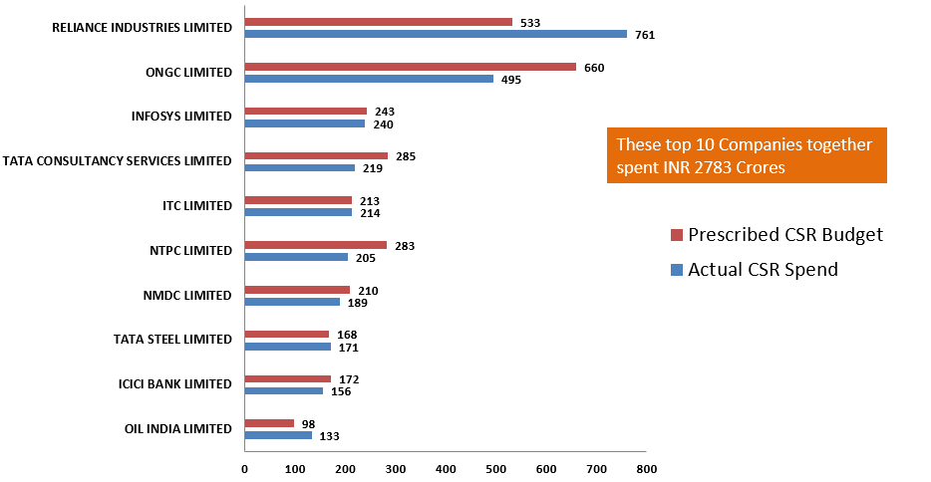

Top 10 companies by CSR spend

Slide 6

Development Sector wise break up of CSR Spend

Slide 7
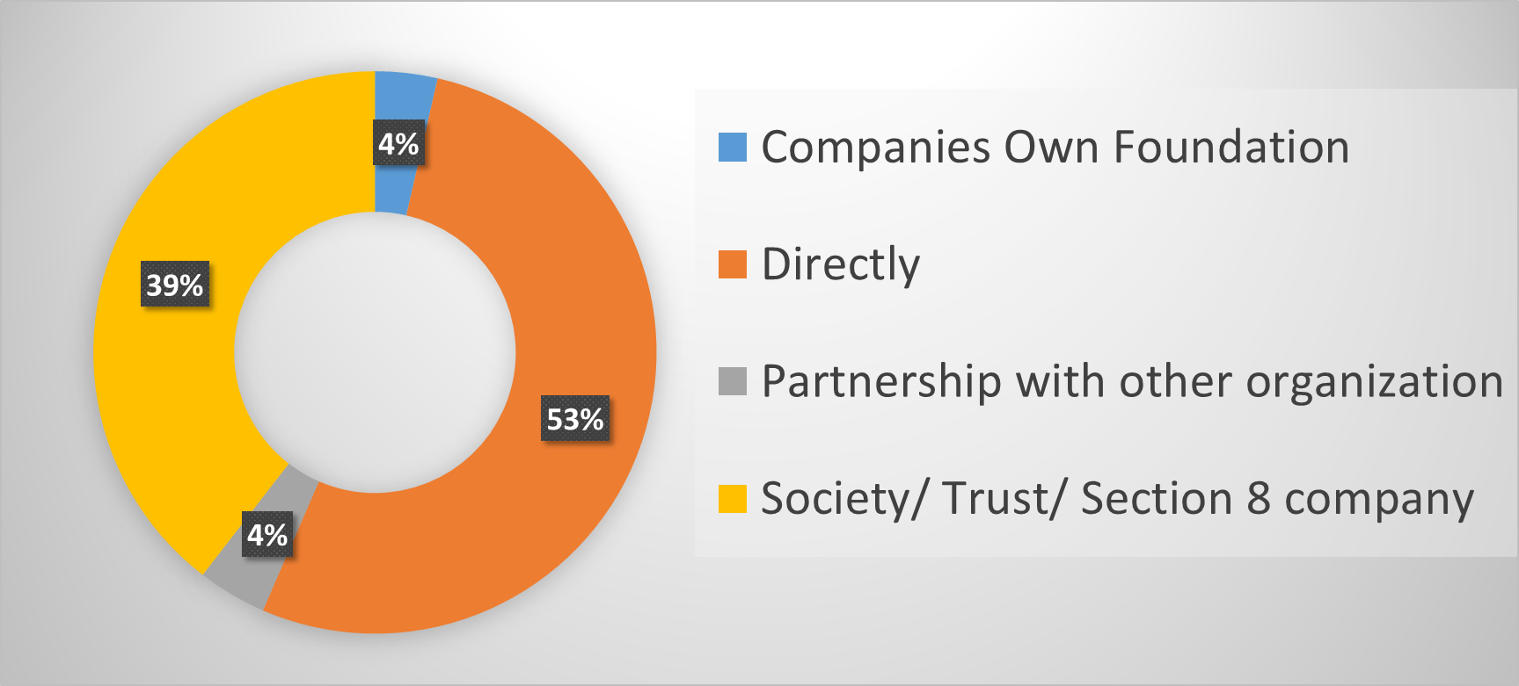

Mode of implementation

Slide 8
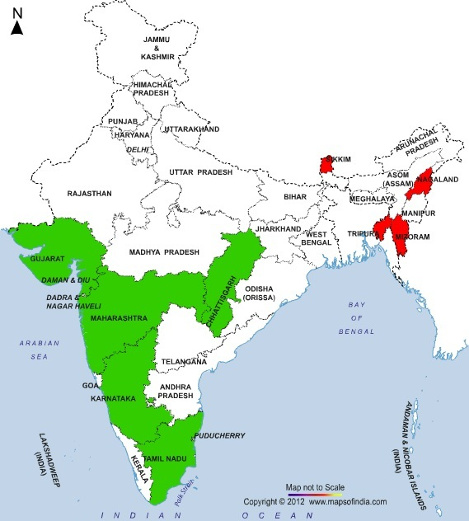

Top and Bottom 5 states
Top Five States | Actual CSR Amt. Spent (in ₹Crore)
Maharashtra | 1101.71
Tamil Nadu | 446.98
Karnataka | 363.05
Gujarat | 291.65
Chhattisgarh | 275.37
Bottom Five States | Actual CSR Amt. Spent (in ₹Crore)
Lakshadweep | 0.59
Sikkim | 0.41
Tripura | 0.34
Mizoram | 0.16
Nagaland | 0.08
Notes:
Top & Bottom Values

Slide 9
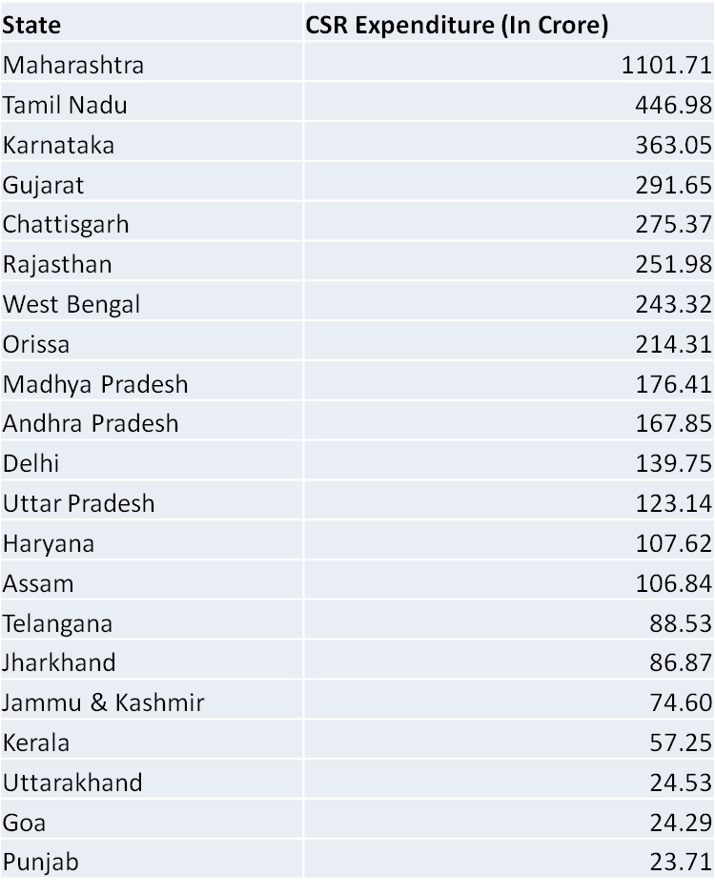
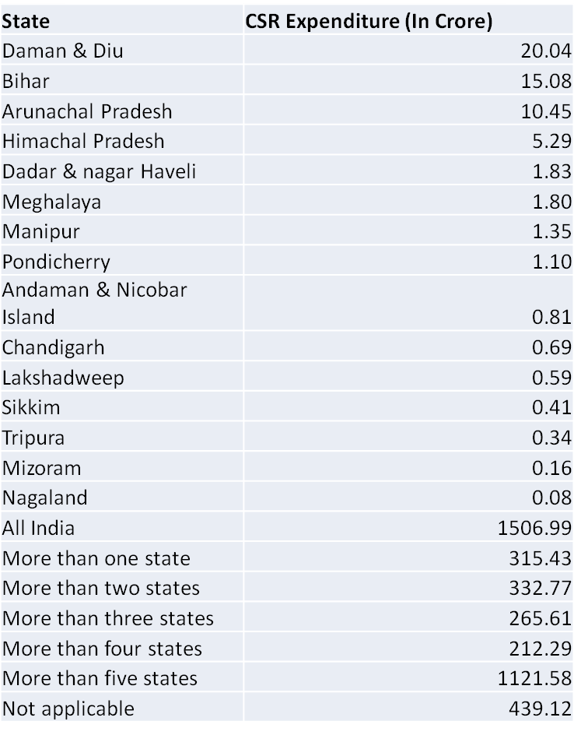
PSUs Vs Non-PSUs Performance (No. of Co.s)

Slide 10

PSUs Vs Non-PSUs Performance (No. of Co.s)

Slide 11
Development Sector wise spend of PSU and Non-PSU

Slide 12
Top reasons for underspend

Slide 13
Reasons given for Zero Spend on CSR
Financial restructuring
Incurred loss
CSR data not found
Non finalization of CSR areas
Company is not required to constitute CSR committee
Board approval for projects delayed
Technical and Procedural difficulty
Many projects were in conceptualization stage
CSR Policy formulation is under process
Location of projects could not be finalized
Company were primarily focused on creating suitable organizational capacity to identify and undertake appropriate CSR programs/projects.
Necessary documents could not be executed to release the amount on CSR activities.
Not formed CSR Committee
Very less resources to execute CSR activities
Projects were approved by CSR committee at the end of financial year
Lack of Clarity on CSR issues
Status of the company doesn't gel with the concept of CSR
Negative impact in the sugar sector
Companies Cash Flow doesn't permit CSR
Spending will commence in due course
The CSR Committee deferred expenditure on CSR

Slide 14
Thanks !!

